Slide 1
S2-19_DSECLZC415 TEXT MINING SESSION 14
AUGUST 16 2020 – Dr.D.VENKATA SUBRAMANIAN
Slide Courtesy: Prof. T.V. Rao

Slide 2

Mining Text Data: An Introduction
Data Mining / Knowledge Discovery
Structured Data Multimedia Free Text Hypertext
HomeLoan (
Loanee: Frank Rizzo
Lender: MWF
Agency: Lake View
Amount: $200,000
Term: 15 years
)
Frank Rizzo bought
his home from Lake
View Real Estate in
1992.
He paid $200,000
under a15-year loan
from MW Financial.
<a href>Frank Rizzo
</a> Bought
<a hef>this home</a>
from <a href>Lake
View Real Estate</a>
In <b>1992</b>.
<p>...
Loans($200K,[map],...)
Notes:
Throughout this course we have been discussing Data Mining over a variety of data types.
Two former types we covered were Structured Data (relational) and multimedia data.
Today and in the last class we have been discussing Data Mining over free text,
and our next section will cover hypertext, such as web pages.
Text mining is well motivated, due to the fact that much of the world’s data can be
found in free text form (newspaper articles, emails, literature, etc.). There is a
lot of information available to mine.
While mining free text has the same goals as data mining in general
(extracting useful knowledge/stats/trends), text mining must overcome
a major difficulty – there is no explicit structure.
Machines can reason will relational data well since schemas are explicitly available.
Free text, however, encodes all semantic information within natural language. Our
text mining algorithms, then, must make some sense out of this natural language
representation. Humans are great at doing this, but this has proved to be a problem for machines.

Slide 4
WHAT IS TEXT MINING
Text mining (also referred to as text analytics) is an artificial intelligence (AI) technology that uses natural language processing (NLP) to transform the free (unstructured) text in documents and databases into normalized, structured data suitable for analysis or to drive machine learning (ML) algorithms.
Text mining identifies facts, relationships and assertions that would otherwise remain buried in the mass of textual big data.
Once extracted, this information is converted into a structured form that can be further analyzed, or presented directly using clustered HTML tables, mind maps, charts, etc.
Text mining employs a variety of methodologies to process the text, one of the most important of these being Natural Language Processing (NLP).
The structured data created by text mining can be integrated into databases, data warehouses or business intelligence dashboards and used for descriptive, prescriptive or predictive analytics.

Slide 5
WHAT IS NLP ?
Natural Language Understanding helps machines “read” text (or another input such as speech) by simulating the human ability to understand a natural language such as English, Spanish or Chinese.
Natural Language Processing includes both Natural Language Understanding and Natural Language Generation, which simulates the human ability to create natural language text e.g. to summarize information or take part in a dialogue.
As a technology, natural language processing has come of age over the past ten years, with products such as Siri, Alexa and Google's voice search employing NLP to understand and respond to user requests. Sophisticated text mining applications have also been developed in fields as diverse as medical research, risk management, customer care, insurance (fraud detection) and contextual advertising.
Today’s natural language processing systems can analyze unlimited amounts of text-based data without fatigue and in a consistent, unbiased manner. They can understand concepts within complex contexts, and decipher ambiguities of language to extract key facts and relationships, or provide summaries. Given the huge quantity of unstructured data that is produced every day, from electronic health records (EHRs) to social media posts, this form of automation has become critical to analysing text-based data efficiently.

Slide 6
WHAT IS STEMMING AND LAMMITIZATION ?
Stemming is the process of reducing a word to its word stem that affixes to suffixes and prefixes or to the roots of words known as a lemma.
"Stemming is the process of reducing inflection in words to their root forms such as mapping a group of words to the same stem even if the stem itself is not a valid word in the Language.“
Stemming is important in Natural Language Understanding and Natural Language Processing.
Lemmatization tries to take a similarly careful approach to removing inflections. Lemmatization does not simply chop off inflections, but instead relies on a lexical knowledge base like WordNet to obtain the correct base forms of words.
For example, WordNet lemmatizes geese to goose and lemmatizes meanness and meaning to themselves.
Stemming is different to Lemmatization in the approach it uses to produce root forms of words and the word produced.
Stemming and Lemmatization are widely used in tagging systems, indexing, SEOs, Web search results, and information retrieval. For example, searching for fish on Google will also result in fishes, fishing as fish is the stem of both words.
Lemmatization is the process of converting a word to its base form. The difference between stemming and lemmatization is, lemmatization considers the context and converts the word to its meaningful base form, whereas stemming just removes the last few characters, often leading to incorrect meanings and spelling errors.

Slide 7
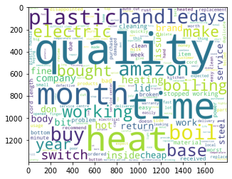
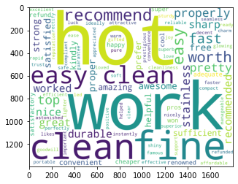
WORD CLOUD
Amazon Kettle review - word cloud
Positive word cloud

Slide 8
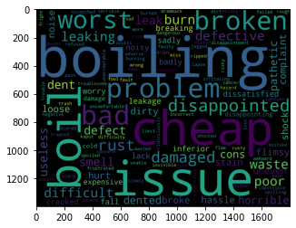
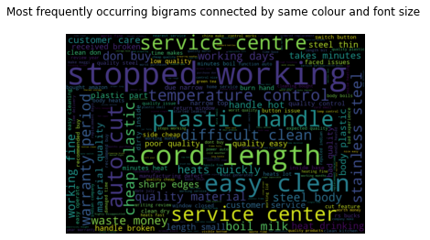
NEGATIVE WORD CLOUD
Bi-gram word cloud:

Slide 9
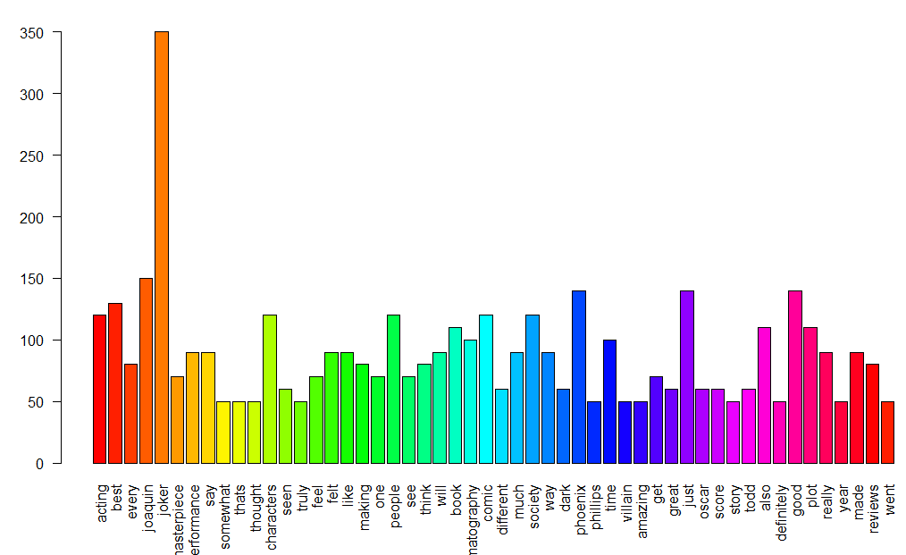
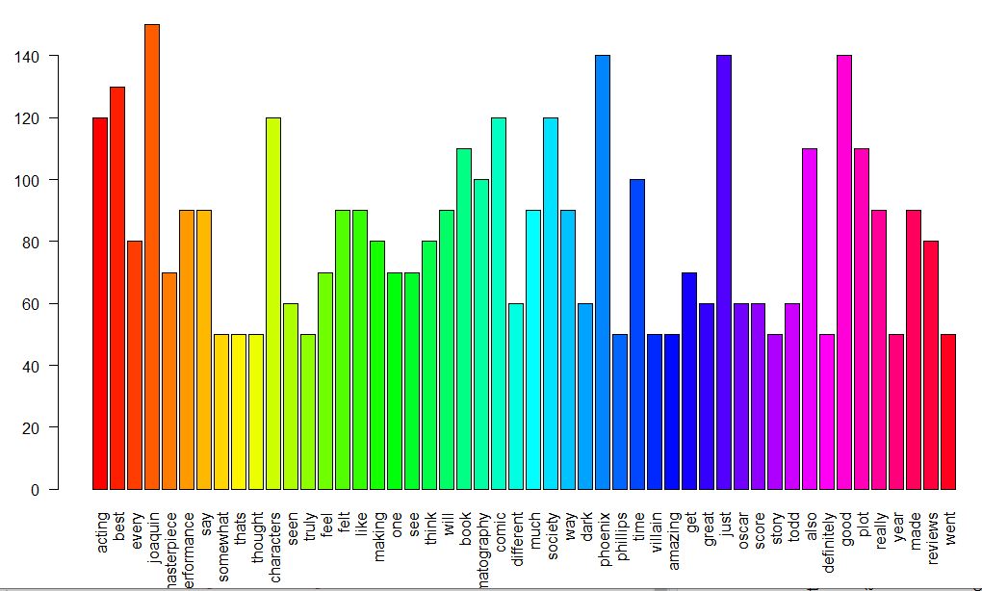
IMDB MOVIES REVIEW COMMENTS

Slide 10
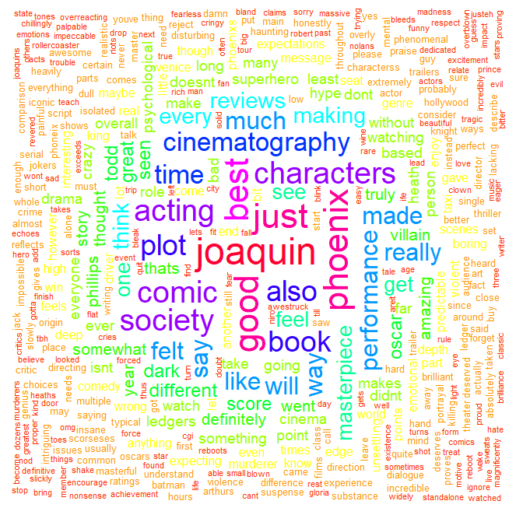

Slide 11
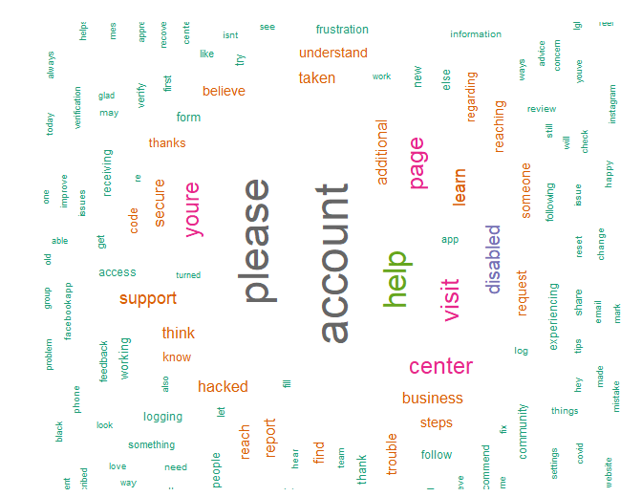

Slide 12
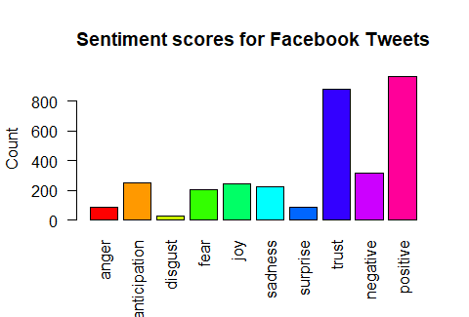

Slide 13
Typically, the tf-idf weight is composed by two terms: the first computes the normalized Term Frequency (TF), aka. the number of times a word appears in a document, divided by the total number of words in that document; the second term is the Inverse Document Frequency (IDF), computed as the logarithm of the number of the documents in the corpus divided by the number of documents where the specific term appears.
TF: Term Frequency, which measures how frequently a term occurs in a document. Since every document is different in length, it is possible that a term would appear much more times in long documents than shorter ones. Thus, the term frequency is often divided by the document length (aka. the total number of terms in the document) as a way of normalization:
TF(t) = (Number of times term t appears in a document) / (Total number of terms in the document).
IDF: Inverse Document Frequency, which measures how important a term is. While computing TF, all terms are considered equally important. However it is known that certain terms, such as "is", "of", and "that", may appear a lot of times but have little importance. Thus we need to weigh down the frequent terms while scale up the rare ones, by computing the following: IDF(t) = log_e(Total number of documents / Number of documents with term t in it).
Example:
Consider a document containing 100 words wherein the word cat appears 3 times. The term frequency (i.e., tf) for cat is then (3 / 100) = 0.03. Now, assume we have 10 million documents and the word cat appears in one thousand of these. Then, the inverse document frequency (i.e., idf) is calculated as log(10,000,000 / 1,000) = 4. Thus, the Tf-idf weight is the product of these quantities: 0.03 * 4 = 0.12.

Slide 14
BAG OF WORDS

Slide 15
EXAMPLE:
He is a good boy
She is a good girl
Boy and girl are good
1st step is to remove all the less important words
This process is known as STOP KEY WORDS

Slide 16
Stop key words
REMOVE ALL THE LESS IMPORTANT WORDS LIKE THE PRONOUNS( he,she,they etc. ) PREPOSITIONS( at,in,on etc.) AND OTHER CONNECTING WORDS.
HENCE THE MAIN WORDS ARE TAKEN EXAMPLE:
good boy
good girl
boy girl good

Slide 17
2nd step is to calculate the frequency of the words:
WORD | FREQUENCY
good | 3
boy | 2
girl | 2
FREQ: NO OF TIMES A WORD OCCURS

Slide 18
3rd step is bag of words converting the table into vector:
 | (f1) | (f2) | (f3)
Sentences | good | boy | girl | o/p
1 | 1 | 1 | 0
2 | 1 | 0 | 1
3 | 1 | 1 | 1

Slide 19
TFIDF
TERM FREQUENCY INVERSE DOCUMENT FREQUENCY

Slide 20
TERM FREQUENCY
FORMULA :
NUMBER OF REPETION OF WORDS IN A SENTENCE
NUMBER OF WORDS IN A SENTENCE
SENTENCE |  | Total words
1 | good boy | 2
2 | good girl | 2
3 | good boy girl | 3
Sentence | good | boy | girl
1. | 1/2 | 1/2 | 0
2. | 1/2 | 0 | 1/2
3. | 1/3 | 1/3 | 1/3

Slide 21
IDF CALCULATION:
FORMULA:
Log no of sentences
no of sentences containing the word
Example:
Good:
log(3/3) = log 1 = 0
NO OF SENTENCES WILL BE THE SAME
HERE IT IS 3
 | No of sentences | No of sentences containing the word | values
Good | 3 | 3 | log3/3
Boy | 3 | 2 | log2/3
girl | 3 | 2 | log2/3

Slide 22
Sentence | good | boy | girl
1. | 1/2 | 1/2 | 0
2. | 1/2 | 0 | 1/2
3. | 1/3 | 1/3 | 1/3
 | No of sentences | No of sentences containing the word | values
Good | 3 | 3 | log3/3 = 0
Boy | 3 | 2 | log2/3
girl | 3 | 2 | log2/3
 | good | boy | girl
Sentence 1 | 0 x 1/2 = 0 | Log2/3 x 1/2 | Log2/3 x 0 = 0
Sentence 2 | 0 x 1/2 = 0 | Log2/3 x 0 = 0 | Log2/3 x 1/2
Sentence 3 | 0 x 1/3 = 0 | Log2/3 x 1/3 | Log2/3 x 1/3

Slide 23
Bag-of-Tokens Approaches
Documents
Token Sets
Four score and seven years ago our fathers brought forth on this continent, a new nation, conceived in Liberty, and dedicated to the proposition that all men are created equal.
Now we are engaged in a great civil war, testing whether that nation, or …
nation – 5
civil - 1
war – 2
men – 2
died – 4
people – 5
Liberty – 1
God – 1
…
Feature
Extraction
Loses all order-specific information!
Severely limits context!
Notes:
The previous text mining presentations “made sense” out of free text by
viewing text as a bag-of-tokens (words, n-grams). This is the same approach as IR.
Under that model we can already summarize, classify, cluster, and compute co-occurrence stats over free text.
These are quite useful for mining and managing large volumes of free text.
However, there is a potential to do much more. The BOT approach loses a LOT of information
contained in text, such as word order, sentence structure, and context. These are precisely the
features that humans use to interpret text.
Thus the natural question is can we do better?

Slide 24
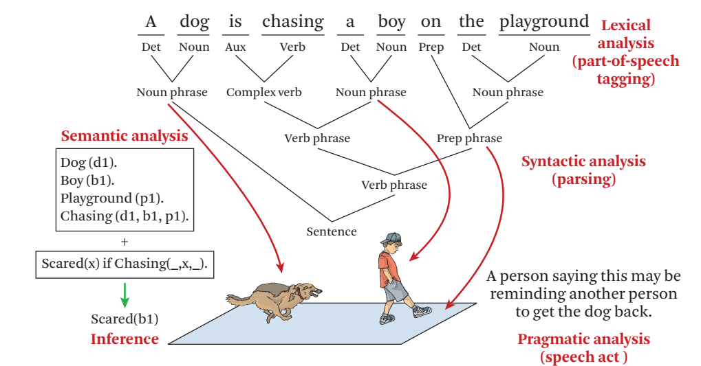
Natural Language Processing
Text Data Management and Analysis: A Practical Introduction to Information Retrieval and Text Mining ChengXiang Zhai, Sean Massung, ACM Books 2016
Notes:
NLP, or Computational Linguistics, is an entire field dedicated to the study
of automatically understanding free text. This field has been active since the 50’s.
General NLP attempts to understand document completely (at the level of a human reader).
There are several steps involved in NLP.
…Blah…

Slide 25
How to Understand Text Data
Lexical analysis. Figure out what the basic meaningful units in a language are (e.g., words in English) and determine the meaning of each word
Syntactic analysis. Determine how words are related with each other in a sentence, thus revealing the syntactic structure of a sentence.
Semantic analysis. Determine the meaning of a sentence. Find meaning of a whole sentence or a larger unit based on the meanings of words and the syntactic structure.
Pragmatic analysis. Determine meaning in context, a deeper understanding of natural language than semantic analysis is thus to further understand the purpose in communication
Discourse analysis. Needed when a large chunk of text with multiple sentences is to be analyzed; in such a case, the connections between these sentences must be considered and the analysis of an individual sentence must be placed in the appropriate context involving other sentences.

Slide 26
General NLP—Too Difficult!
Word-level ambiguity
“design” can be a noun or a verb (Ambiguous POS)
“root” has multiple meanings (Ambiguous sense)
Syntactic ambiguity
“natural language processing” (Modification)
“A man saw a boy with a telescope.” (PP Attachment)
Anaphora resolution
“John persuaded Bill to buy a TV for himself.”
(himself = John or Bill?)
Presupposition
“He has quit smoking.” implies that he smoked before.
Humans rely on context to interpret (when possible).
This context may extend beyond a given document!
Notes:
General NLP has proven to be too difficult. It is dubbed “AI-Complete”, meaning that such a
program would basically have to have near-human intelligence (i.e. solve AI).
The reason NLP in general is so difficult is that text is highly ambiguous. NL is meant for
human consumption and often contains ambiguities under the assumption that humans
will be able to develop context and interpret the intended meaning.
For instance [rewind], in this example the sentence could mean that either the dog, or the boy, or both
are on the playground. As a human we know that it is probably both, but that is due to our
knowledge that a dog is probably chasing close behind the boy, playgrounds are large,
they are probably playing, and a playground is a place to play. This background knowledge
probably is not contained in a document containing this sentence.
Despite such obstacles, computational linguists have made great progress on several subproblems.
We will now talk about four of these subproblems.

Slide 27
Shallow Linguistics
Progress on Useful Sub-Goals:
English Lexicon
Part-of-Speech Tagging
Word Sense Disambiguation
Phrase Detection / Parsing
Notes:
Several subgoals to NLP have been addressed to derive more info than just bag-of-tokens view.
English lexicon, POS Tagging, WSD, Parsing
Even with imperfect performance, these solutions already open the door for more intelligent text processing.

Slide 28
WordNet
An extensive lexical network for the English language
a large lexical database of English. Nouns, verbs, adjectives and adverbs grouped into sets of cognitive synonyms expressing a distinct concept, hosted at wordnet.princeton.edu, seems inactive now
Contains over 138,838 words.
Several graphs, one for each part-of-speech.
Synsets (synonym sets), each defining a semantic sense.
Relationship information (antonym, hyponym, meronym …)
Downloadable for free (UNIX, Windows)
Expanding to other languages (Global WordNet Association)
Funded >$3 million, mainly government (translation interest)
Founder George Miller, National Medal of Science, 1991.
watery
parched
moist
wet
dry
arid
synonym
antonym
damp
anhydrous
Notes:
WordNet is an extensive lexical network for the human language.
Consists of a graph of synsets for each part of speech. Contains synonym and antonym relationships.
(hyponym=isa/subset, maple is a tree -> maple is a hyponym of tree)
(meronym=hasa, tree has a leaf -> leaf is a meronym of tree)
As will see, this is useful throughout NLP/ShallowLinguistics.
This encodes some of the lexicon that humans carry with them when interpreting text.

Slide 29
Word Sense Disambiguation
“The difficulties of computational linguistics are rooted in ambiguity.”
N Aux V P N
Supervised Learning
Features:
Neighboring POS tags (N Aux V P N)
Neighboring words (linguistics are rooted in ambiguity)
Stemmed form (root)
Dictionary/Thesaurus entries of neighboring words
High co-occurrence words (plant, tree, origin,…)
Other senses of word within discourse
Algorithms:
Rule-based Learning
Statistical Learning (i.e. Naïve Bayes)
Unsupervised Learning (i.e. Nearest Neighbor)
Notes:
WSD attempts to resolve ambiguity by labeling each word with a precise sense, as intended in the document.
This is typically performed after POS tagging, since POS tags are quite useful for WSD.
Current approaches address this as a supervised learning problem.
Features include neighboring words w/ POS tags, stemmed form of word, high co-occurrence words (with stem).
Quite a few supervised learning algorithms have been applied (rule-lists, bayesian, NN).
Performance depends heavily upon the particular text, but from what I’ve read 90%+ accuracy is common.

Slide 30
Parsing
Choose most likely parse tree…
S
Probability of this tree=0.000015
Probabilistic CFG
NP
VP
S→ NP VP
NP → Det BNP
NP → BNP
NP→ NP PP
BNP→ N
VP → V
VP → Aux V NP
VP → VP PP
PP → P NP
V → chasing
Aux→ is
N → dog
N → boy
N→ playground
Det→ the
Det→ a
P → on
1.0
0.3
0.4
0.3
Det
BNP
VP
PP
A
N
Aux
V
NP
P
NP
Grammar
…
dog
is
chasing
on
a boy
…
.
the playground
.
.
1.0
S
Probability of this tree=0.000011
NP
VP
0.01
Det
NP
BNP
Aux
V
0.003
PP
Lexicon
A
N
is
chasing
NP
P
NP
…
dog
a boy
on
…
the playground
Notes:
Parsing attempts to infer the precise grammatical relationships between different words in a given sentence.
For example, POS are grouped into phrases and phrases are combined into sentences.
Approaches include parsing with probabilistic CFG’s, “link dictionaries”, and tree adjoining techniques (super-tagging).
Current techniques can only parse at the sentence level, in some cases reporting accuracy in the 90% range.
Again, the performance heavily depends upon the grammatical correctness and the degree of ambiguity of the text.

Slide 31
Obstacles
Ambiguity
“A man saw a boy with a telescope.”
Computational Intensity
Imposes a context horizon.
Text Mining NLP Approach:
Locate promising fragments using fast IR methods (bag-of-tokens).
Only apply slow NLP techniques to promising fragments.
Notes:
The biggest obstacle to sophisticated NLP is ambiguity. Humans are quite skilled at inferring context and meaning.
NLP is expensive and can currently only be performed on the small scale (per-sentence, selective sentences).
This restriction further limits our ability to derive context (from across the document).
Current approach is to use fast IR techniques (bag-of-tokens) to determine promising text fragments and then apply more expensive NLP techniques on those fragments. (same idea is in multimedia mining)

Slide 32
Summary: Shallow NLP
However, shallow NLP techniques are feasible and useful:
Lexicon – machine understandable linguistic knowledge
possible senses, definitions, synonyms, antonyms, typeof, etc.
POS Tagging – limit ambiguity (word/POS), entity extraction
“...research interests include text mining as well as bioinformatics.”
WSD (word sense disambiguation) – stem/synonym/hyponym matches (doc and query)
Query: “Foreign cars” Document: “I’m selling a 1976 Jaguar…”
Parsing – logical view of information (inference?, translation?)
“A man saw a boy with a telescope.”
Even without complete NLP, any additional knowledge extracted from text data can only be beneficial.
Ingenuity will determine the applications.
Notes:
Even though general NLP is elusive, the subgoals presented here already provide opportunity for more intelligent text processing/analysis.
POS Tagging can provide a basis for extracting relations/facts (IE – HMM approach example).
WSD can resolve semantic ambiguities at the word-level. Even interpret synonyms as related. (laptop, notebook) (in document and query)
Parsing can translate free text into a logical, machine-understandable representation of the stated “knowledge”. (MT?, Inference?)
Rest is up to ingenuity, but it seems clear that as more of the knowledge encoded in text can be machine-understood we will be able to build systems to more intelligently work/reason with textual data.

Slide 33
Text Databases and IR
Text databases (document databases)
Large collections of documents from various sources: news articles, research papers, books, digital libraries, e-mail messages, and Web pages, library database, etc.
Data stored is usually semi-structured
Traditional information retrieval techniques become inadequate for the increasingly vast amounts of text data
Information retrieval
A field developed in parallel with database systems
Information is organized into (a large number of) documents
Information retrieval problem: locating relevant documents based on user input, such as keywords or example documents

Slide 34
Information Retrieval
Typical IR systems
Online library catalogs
Online document management systems
Information retrieval vs. database systems
Some DB problems are not present in IR, e.g., update, transaction management, complex objects
Some IR problems are not addressed well in DBMS, e.g., unstructured documents, approximate search using keywords and relevance

Slide 35
Basic Measures for Text Retrieval
Relevant
Relevant & Retrieved
Retrieved
All Documents
Precision: the percentage of retrieved documents that are in fact relevant to the query (i.e., “correct” responses)
Recall: the percentage of documents that are relevant to the query and were, in fact, retrieved

Slide 36
Information Retrieval Techniques
Basic Concepts
A document can be described by a set of representative keywords called index terms.
Different index terms have varying relevance when used to describe document contents.
This effect is captured through the assignment of numerical weights to each index term of a document. (e.g.: frequency, tf-idf)
DBMS Analogy
Index Terms → Attributes
Weights → Attribute Values

Slide 37
Information Retrieval Techniques
Index Terms (Attribute) Selection:
Stop list
Word stem
Index terms weighting methods
Terms  Documents Frequency Matrices
Information Retrieval Models:
Boolean Model (simplistic)
Vector Space Model (Document Ranking considered)
Etc.

Slide 38
Boolean Model
Consider that index terms are either present or absent in a document
As a result, the index term weights are assumed to be all binaries
A query is composed of index terms linked by three connectives: not, and, and or
e.g.: car and repair, plane or airplane
The Boolean model predicts that each document is either relevant or non-relevant based on the match of a document to the query

Slide 39
Keyword-Based Retrieval
A document is represented by a string, which can be identified by a set of keywords
Queries may use expressions of keywords
E.g., car and repair shop, tea or coffee, DBMS but not Oracle
Queries and retrieval should consider synonyms, e.g., repair and maintenance
Major difficulties of the model
Synonymy: A keyword T does not appear anywhere in the document, even though the document is closely related to T, e.g., data mining
Polysemy: The same keyword may mean different things in different contexts, e.g., mining

Slide 40
Similarity-Based Retrieval in Text Data
Finds similar documents based on a set of common keywords
Answer should be based on the degree of relevance based on the nearness of the keywords, relative frequency of the keywords, etc.
Basic techniques
Stop list
Set of words that are deemed “irrelevant”, even though they may appear frequently
E.g., a, the, of, for, to, with, etc.
Stop lists may vary when document set varies

Slide 41
Similarity-Based Retrieval in Text Data
Word stem
Several words are small syntactic variants of each other since they share a common word stem
E.g., drug, drugs, drugged
A term frequency table
Each entry frequent_table(i, j) = # of occurrences of the word t_{i} in document d_{i}
Usually, the ratio instead of the absolute number of occurrences is used
Similarity metrics: measure the closeness of a document to a query (a set of keywords)
Relative term occurrences
Cosine distance:

Slide 42
Vector Space Model
Represent a doc by a term vector
Term: basic concept, e.g., word or phrase
Each term defines one dimension
N terms define a N-dimensional space
Element of vector corresponds to term weight
E.g., d = (x₁,…,x_{N}), x_{i} is “importance” of term i
New document is assigned to the most likely category based on vector similarity.

Slide 43
What VS Model Does Not Specify
How to select terms to capture “basic concepts”
Word stopping
e.g. “a”, “the”, “always”, “along”
Word stemming
e.g. “computer”, “computing”, “computerize” => “compute”
Latent semantic indexing
How to assign weights
Not all words are equally important: Some are more indicative than others
e.g. “algebra” vs. “science”
How to measure the similarity

Slide 44
How to Assign Weights
Two-fold heuristics based on frequency
TF (Term frequency)
More frequent within a document → more relevant to semantics
IDF (Inverse document frequency)
Less frequent among documents → more discriminative

Slide 45

TF Weighting
Weighting:
More frequent => more relevant to topic
Raw TF= f(t,d): how many times term t appears in doc d
Normalization:
Document length varies => relative frequency preferred
e.g., Maximum frequency normalization

Slide 46

IDF Weighting
Ideas:
Less frequent among documents → more discriminative
Formula:
n — total number of docs
k — # docs with term t appearing
(the DF document frequency)

Slide 47
TF-IDF Weighting
TF-IDF weighting : weight(t, d) = TF(t, d) * IDF(t)
Freqent within doc → high tf → high weight
Selective among docs → high idf → high weight
Recall VS model
Each selected term represents one dimension
Each doc is represented by a feature vector
Its t-term coordinate of document d is the TF-IDF weight
This is more reasonable
Just for illustration …
Many complex and more effective weighting variants exist in practice

Slide 48



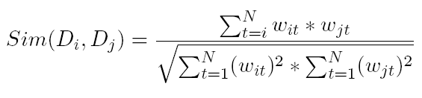
How to Measure Similarity?
Given two document
Similarity definition
dot product
normalized dot product (or cosine)

Slide 49
Illustrative Example
text
mining
search
engine
text
doc1
Sim(newdoc,doc1)=4.8*2.4+4.5*4.5
Sim(newdoc,doc2)=2.4*2.4
Sim(newdoc,doc3)=0
To whom is newdoc more similar?
travel
text
map
travel
doc2
text mining travel map search engine govern president congress
IDF(faked) 2.4 4.5 2.8 3.3 2.1 5.4 2.2 3.2 4.3
doc1 2(4.8) 1(4.5) 1(2.1) 1(5.4)
doc2 1(2.4 ) 2 (5.6) 1(3.3)
doc3 1 (2.2) 1(3.2) 1(4.3)
newdoc 1(2.4) 1(4.5)
government
president
congress
doc3
……

Slide 50
VS Model-Based Classifiers
What do we have so far?
A feature space with similarity measure
This is a classic supervised learning problem
Search for an approximation to classification hyper plane
VS model based classifiers
K-NN
Decision tree based
Neural networks
Support vector machine

Slide 51
Probabilistic Retrieval Models
The ranking function based on the probability that a given document d is relevant to a query q,
or p(R = 1| d, q) where R ∈ {0, 1} is a binary random variable denoting relevance.
In query likelihood retrieval model (one of the probabilistic models), we assume that this probability of relevance can be approximated by the probability of a query given a document and relevance,
p(q | d, R = 1).
Intuitively, if a user likes document d, how likely would the user enter query q in order to retrieve document d?

Slide 52
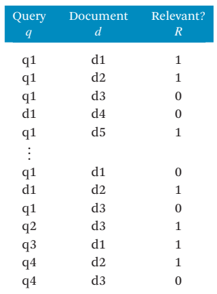
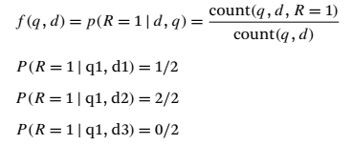

Probabilistic Retrieval Models
Clearly, p(R = 1 | d, q) + p(R = 0 | d, q) = 1

Slide 53
Summary: Text Categorization
Wide application domain
Comparable effectiveness to professionals
Manual TC is not 100% and unlikely to improve substantially.
A.T.C. is growing at a steady pace
Prospects and extensions
Very noisy text, such as text from O.C.R.
Speech transcripts

Slide 54
Types of Text Data Mining
Keyword-based association analysis
Automatic document classification
Similarity detection
Cluster documents by a common author
Cluster documents containing information from a common source
Link analysis: unusual correlation between entities
Sequence analysis: predicting a recurring event
Anomaly detection: find information that violates usual patterns
Hypertext analysis
Patterns in anchors/links
Anchor text correlations with linked objects

Slide 55
Keyword-Based Association Analysis
Motivation
Collect sets of keywords or terms that occur frequently together and then find the association or correlation relationships among them
Association Analysis Process
Preprocess the text data by parsing, stemming, removing stop words, etc.
Evoke association mining algorithms
Consider each document as a transaction
View a set of keywords in the document as a set of items in the transaction
Term level association mining
No need for human effort in tagging documents
The number of meaningless results and the execution time is greatly reduced

Slide 56
Text Classification
Motivation
Automatic classification for the large number of on-line text documents (Web pages, e-mails, corporate intranets, etc.)
Classification Process
Data preprocessing
Definition of training set and test sets
Creation of the classification model using the selected classification algorithm
Classification model validation
Classification of new/unknown text documents
Text document classification differs from the classification of relational data
Document databases are not structured according to attribute-value pairs

Slide 57
Document Clustering
Motivation
Automatically group related documents based on their contents
No predetermined training sets or taxonomies
Generate a taxonomy at runtime
Clustering Process
Data preprocessing: remove stop words, stem, feature extraction, lexical analysis, etc.
Hierarchical clustering: compute similarities applying clustering algorithms.
Model-Based clustering (Neural Network Approach): clusters are represented by “exemplars”. (e.g.: SOM)

Slide 58
Challenges in Mining WWW
The Web is too huge for effective data warehousing and data mining. It is barely possible to set up a data warehouse to replicate, store, or integrate all of the data on the Web
The complexity of Web pages is far greater than that of any traditional text document collection. There is no index by category, nor by title, author, cover page, table of contents, etc.
The Web is a highly dynamic information source. Not only does the Web grow rapidly, but is also constantly updated. Linkage information and access records are also updated frequently
The Web serves a broad diversity of user communities. Users may have very different backgrounds, interests, and usage purposes.
Only a small portion of the information on the Web is truly relevant or useful. It is said that 99% of the Web information is useless to 99% of Web users. How can the portion of the Web that is truly relevant to your interest be determined? How can we find high quality Web pages on a specified topic?
Notes:
Noise:
First, web pages usually do not contain pure content. A web page typically contains various types of materials that are not related to the topic of the web-page.
Multiple topics:
Secondly, a web page usually contains multiple topics, for example, a news page containing many different comments on a particular event or politician, or a conference web page containing sponsors from different companies and organizations. Although traditional documents also often have multiple topics, they are less diverse so that the impact on retrieval performance is smaller.
There exist some new characteristics in web pages:
Two-Dimension Logical Structure – Different from free-text documents, web pages have a 2-D view and a more sophisticated internal content structure. Each block of a web page could have relationships with blocks from up to four directions and contain or be contained in some other blocks. A content structure in semantic level exists for most pages and can be used to enhance retrieval.
Visual Layout Presentation – To facilitate browsing and attract attention, web pages usually contain much visual information in the tags and properties in HTML [20]. Typical visual hints include lines, blank areas, colors, pictures, fonts, etc. Visual cues are very helpful to detect the semantic regions in web pages.

Slide 59
Search Engine – Two Rank Functions
Ranking based on link structure analysis
Search
Rank Functions
Importance Ranking
Similarity based on content or text
(Link Analysis)
Relevance Ranking
Backward Link
Web Topology
Indexer
(Anchor Text)
Graph
Inverted
Index
Anchor Text
Web Graph
Generator
Constructor
Term Dictionary
Meta Data
Forward
Forward
URL
(Lexicon)
Index
Link
Dictioanry
Web Page Parser
Web Pages

Slide 60
Relevance Ranking
Inverted index
- A data structure for supporting text queries
- like index in a book
aalborg 3452, 11437, …..
.
.
.
.
.
arm 4, 19, 29, 98, 143, ...
armada 145, 457, 789, ...
armadillo 678, 2134, 3970, ...
armani 90, 256, 372, 511, ...
.
.
.
.
.
zz 602, 1189, 3209, ...
indexing
disks with
documents
inverted index

Slide 61
Introduction on PageRank
PageRank is a link analysis algorithm … with the purpose of "measuring" its (Webpage) relative importance within the set.
– From Wikipedia, the free encyclopedia
Developed by Larry Page as his PhD research topic
3 years later, he quit Stanford and founded Google with Brin
Apparently Larry Page had lost his PhD qualification.

Slide 62
PageRank: the intuitive idea
PageRank relies on the democratic nature of the Web by using its vast link structure as an indicator of an individual page's value or quality.
PageRank interprets a hyperlink from page x to page y as a vote, by page x, for page y.
However, PageRank looks at more than the sheer number of votes; it also analyzes the page that casts the vote.
Votes casted by “important” pages weigh more heavily and help to make other pages more "important."
This is exactly the idea of rank prestige in social network.

Slide 63
More specifically …
A hyperlink from a page to another page is an implicit conveyance of authority to the target page.
The more in-links that a page i receives, the more prestige the page i has.
Pages that point to page i also have their own prestige scores.
A page of a higher prestige pointing to i is more important than a page of a lower prestige pointing to i.
In other words, a page is important if it is pointed to by other important pages.

Slide 64
PageRank algorithm
According to rank prestige, the importance of page i (i’s PageRank score) is the sum of the PageRank scores of all pages that point to i.
Since a page may point to many other pages, its prestige score should be shared.
The Web as a directed graph G = (V, E). Let the total number of pages be n. The PageRank score of the page i (denoted by P(i)) is defined by:
O_{j} is the number of out-link of j

Slide 65
Matrix notation
We have a system of n linear equations with n unknowns. We can use a matrix to represent them.
Let P be a n-dimensional column vector of PageRank values, i.e., P = (P(1), P(2), …, P(n))^{T}.
Let A be the adjacency matrix of our graph with
We can write the n equations with (PageRank)

Slide 66
Calculation of PageRank on Webpage
A
B
C
D
R(.) = PageRank of a Webpage
R(A) = 100%R(B) + 50%R(C)
R(B) = 50%R(C) + 100%R(D)
R(C) = 100%R(A)

Slide 67
HITS
HITS stands for Hypertext Induced Topic Search. (developed by Jon Kleinberg in 1998 – used by Ask.com)
Unlike PageRank which is a static ranking algorithm, HITS is search query dependent.
When the user issues a search query,
HITS first expands the list of relevant pages returned by a search engine and
then produces two rankings of the expanded set of pages, authority ranking and hub ranking.
Authority: Roughly, a authority is a page with many in-links.
The idea is that the page may have good or authoritative content on some topic and
thus many people trust it and link to it.
Hub: A hub is a page with many out-links.
The page serves as an organizer of the information on a particular topic and
points to many good authority pages on the topic.

Slide 68
The HITS algorithm: Grab pages
Given a broad search query, q, HITS collects a set of pages as follows:
It sends the query q to a search engine.
It then collects t (t = 200 is used in the HITS paper) highest ranked pages. This set is called the root set W.
It then grows W by including any page pointed to by a page in W and any page that points to a page in W. This gives a larger set S, base set.

Slide 69
The link graph G
HITS works on the pages in S, and assigns every page in S an authority score and a hub score.
Let the number of pages in S be n.
We again use G = (V, E) to denote the hyperlink graph of S.
We use L to denote the adjacency matrix of the graph.

Slide 70
The HITS algorithm
Let the authority score of the page i be a(i), and the hub score of page i be h(i).
The mutual reinforcing relationship of the two scores is represented as follows:

Slide 71
Strengths and weaknesses of HITS
Strength: its ability to rank pages according to the query topic, which may be able to provide more relevant authority and hub pages.
Weaknesses:
It is easily spammed. It is in fact quite easy to influence HITS since adding out-links in one’s own page is so easy.
Topic drift. Many pages in the expanded set may not be on topic.
Inefficiency at query time: The query time evaluation is slow. Collecting the root set, expanding it and performing eigenvector computation are all expensive operations

Slide 72
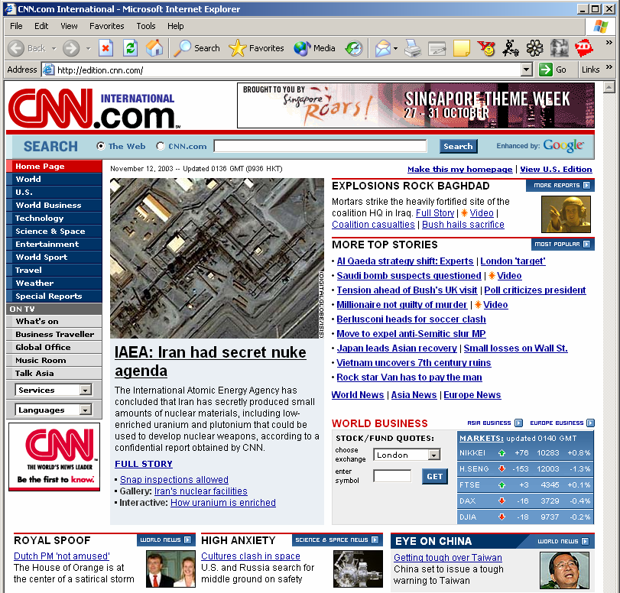
Layout Structure
Compared to plain text, a web page is a 2D presentation
Rich visual effects created by different term types, formats, separators, blank areas, colors, pictures, etc
Different parts of a page are not equally important
Title: CNN.com International
H1: IAEA: Iran had secret nuke agenda
H3: EXPLOSIONS ROCK BAGHDAD
…
TEXT BODY (with position and font type): The International Atomic Energy Agency has concluded that Iran has secretly produced small amounts of nuclear materials including low enriched uranium and plutonium that could be used to develop nuclear weapons according to a confidential report obtained by CNN…
Hyperlink:
URL: http://www.cnn.com/...
Anchor Text: AI oaeda…
Image:
URL: http://www.cnn.com/image/...
Alt & Caption: Iran nuclear …
Anchor Text: CNN Homepage News …

Slide 73
Web Page Block—Better Information Unit
Web Page Blocks
Importance = Low
Importance = Med
Importance = High

Slide 74
VIPS (VIsion-based Page Segmentation) proposed at UIUC
OVERCOMES Problems of treating a web page as an atomic unit
Web page usually contains not only pure content
Noise: navigation, decoration, interaction, …
Multiple topics
Different parts of a page are not equally important
Web page has internal structure
Two-dimension logical structure & Visual layout presentation
> Free text document
< Structured document
Layout – the 3rd dimension of Web page
1st dimension: content
2nd dimension: hyperlink
Notes:
Noise:
First, web pages usually do not contain pure content. A web page typically contains various types of materials that are not related to the topic of the web-page.
Multiple topics:
Secondly, a web page usually contains multiple topics, for example, a news page containing many different comments on a particular event or politician, or a conference web page containing sponsors from different companies and organizations. Although traditional documents also often have multiple topics, they are less diverse so that the impact on retrieval performance is smaller.
There exist some new characteristics in web pages:
Two-Dimension Logical Structure – Different from free-text documents, web pages have a 2-D view and a more sophisticated internal content structure. Each block of a web page could have relationships with blocks from up to four directions and contain or be contained in some other blocks. A content structure in semantic level exists for most pages and can be used to enhance retrieval.
Visual Layout Presentation – To facilitate browsing and attract attention, web pages usually contain much visual information in the tags and properties in HTML [20]. Typical visual hints include lines, blank areas, colors, pictures, fonts, etc. Visual cues are very helpful to detect the semantic regions in web pages.

Slide 75
VIPS
Index block instead of whole page
Block retrieval
Combing DocRank and BlockRank
Block query expansion
Select expansion term from relevant blocks
More improvement on web search can be made by mining webpage Layout structure
Leverage visual cues for web information analysis & information extraction

Slide 76
Thank You

